Slide 1

PHP Memory Optimization
Date : 26-03-2019
Presented by : Deepak Porwal

Slide 2
What we’ll cover together
Our mission is to be the leader in enabling the global publishing and educational institu
tions to deliver online and offline learning
How memory management done by PHP?
What is PHP memory limit ?
How to measure memory consumption?
PHP Memory optimization technique
Example
Notes:
This is topic for optimization.
‹#›

Slide 3
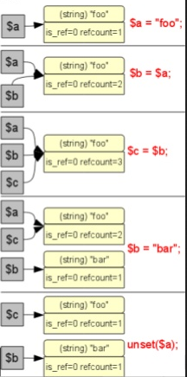

Understanding PHP memory management
PHP uses a CoW(CopyOnWrite) system for zval.
PHP is a dynamic, loosely typed language, that uses
copy-on-write and reference counting. http://php.net/manual/en/internals2.variables.intro.php
All variables in PHP are represented by one structure,
the zval:
Memory gets allocated only on change.
PHP memory management done by ZendMM
http://www.phpinternalsbook.com/php7/memory_management/zend_memory_manager.html
Notes:
‹#›

Slide 4

Understanding PHP memory limit
What is memory limit?
PHP memory_limit is the maximum amount of server memory a single PHP script is allowed to consume.
PHP memory_limit is per-script, just as a highway speed limit is per-vehicle.
Notes:
‹#›

Slide 5
Measuring PHP memory consumption
Not much tools, few are:
OS help (/proc, top, pmap etc)
PHP Function: memory_get_usage() http://php.net/manual/en/function.memory-get-usage.php
PHP Extension
Xdebug (https://xdebug.org/docs/index.php)
memprof
memtrack
Notes:
‹#›

Slide 6
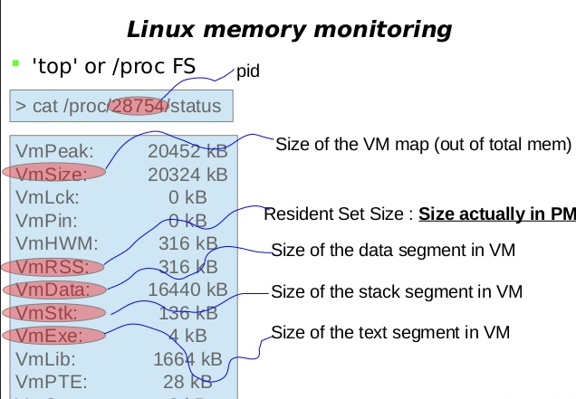
Measuring PHP memory consumption
OS help (/proc, top, pmap etc)
Notes:
‹#›

Slide 7
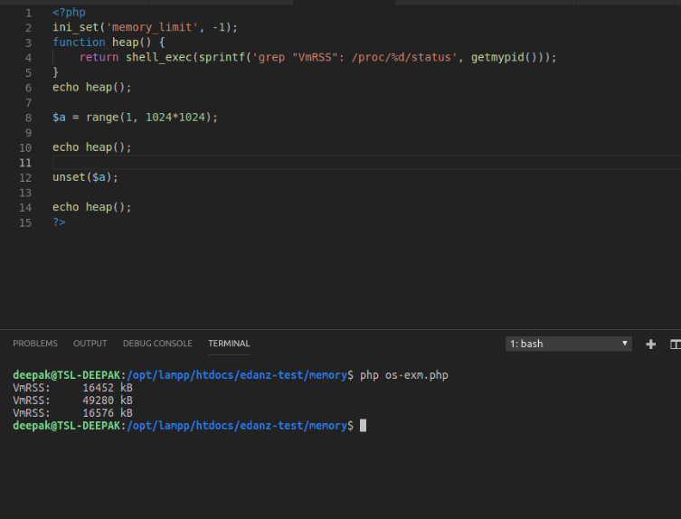
Measuring PHP memory consumption
Example from OS help
Notes:
‹#›

Slide 8
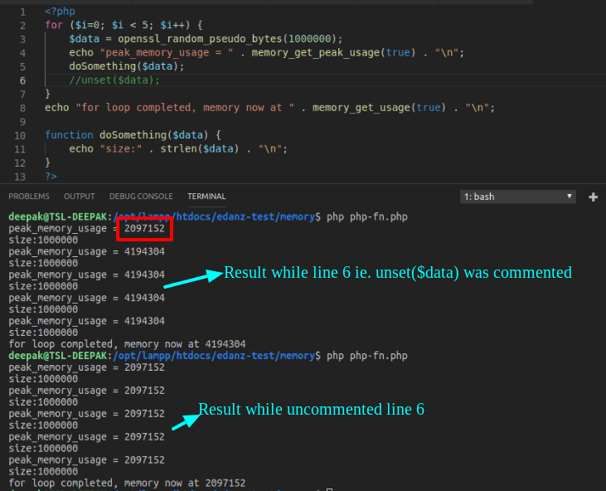
Measuring PHP memory consumption
Measuring memory consumption using PHP function
Notes:
‹#›

Slide 9
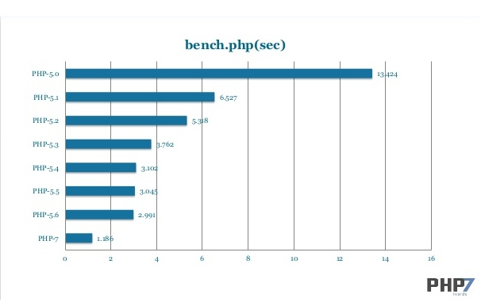
PHP Memory optimization technique (1/6)
Using the Latest Version of PHP
Double Quotes (“) and Single quotes (‘)
Avoiding Relative Path In File Inclusion
Releasing all Resources
Notes:
‹#›

Slide 10
PHP Memory optimization technique (2/6)
Identity 1===1 vs Equality ‘1’ == 1 [1.63 : 3.72 @10,000,000]
Don’t make needless copies.
echo $a,$b; faster that echo $a.$b; [1.11:2.48 @ 1,000,000]
Pre increment ++$i faster that post increment $i++ [0.95 : 1.05 @ 10,000,000]
“foreach” for arrays better than “for”. According to benchmark “foreach > for > while”
[1.38 : 4.35 @ 100,000]
Using undefined variables is slower than preinitialized variables [0.82 : 4.41 @ 10,000,000]
switch is faster that if(..) & elseif(..)
Notes:
‹#›

Slide 11
PHP Memory optimization technique (3/6)
User ctype_alnum(), ctype_alpha() & ctype_digit over regex. More Character type checking function can be find here: http://php.net/manual/en/ref.ctype.php
Never Use Count or Any Other methods in The Condition Section of a Loop
for ($x = 0; $x < count($array); $x++) - Wrong $count = count($array); for ($x = 0; $x < $count; $x++) - Correct
Using ISSET
Instead of using count(), strlen(), sizeof(), it is better as well as safer to use isset(). Ex. Instead of (strlen($foo) < 50) we can use (!isset($foo{50})).
str_replace is faster than preg_replace, and strtr is faster than str_replace
Notes:
‹#›

Slide 12
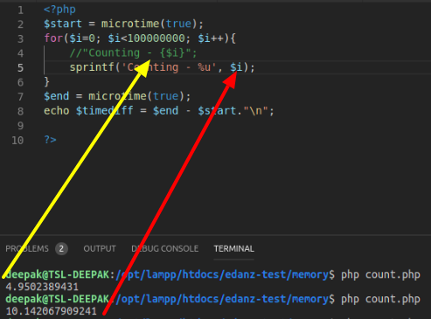
PHP Memory optimization technique (4/6)
“{$var}” is faster than sprintf(..) [2.19 : 6.87 @10,000,000]
Notes:
‹#›

Slide 13
PHP Memory optimization technique (5/5)
Reuse function results:
<?php
// Non-optimized
if(get_option('some_setting') > 0) {
$var = get_option('some_setting');
}
else {
$var = 0;
}
// Optimized:
if($var = get_option('some_setting') < 0) {
$var = 0;
}
Notes:
‹#›

Slide 14
PHP Memory optimization technique (6/6)
Ordering of Conditions:
if(fastest() || fast() || slowest()) {
// some code
}
Avoid using database queries into large loop.
Use mysqli_free_result() once you are done with the result data. Ex: function longRunningProcess() { $result = mysqli_query($query);
$data = formatData($result); mysqli_free_result($result); //free the result before doing more processing
}
Notes:
‹#›

Slide 15
Example
class ProductExporter
{
public function export($page)
{
$category = new Category();
$products = $this->getProductsByPage($page);
$export = array();
foreach ($products as $product) {
// getById is being called N times
$export[‘category’] = $category->getById($product['category_id']);
// Get other aspects of project..
$this->writeToCSV($export);
}
}
}
class Category
{
public function getById($id)
{
// this can be very expensive db operation
$raw = $this->getNestedTree($id);
$processed = $this->process($raw);
return $processed;
}
...
}
//Solution 1: class Category
{
private $cache = array();
public function getById($id)
{
if (!isset($this->cache[$id])) {
$raw = $this->getNestedTree($id);
$processed = $this->process($raw);
$this->cache[$id] = $data;
}
return $this->cache[$id];
}
...
}
Notes:
‹#›

Slide 16
Example
// Solution 2
class CappedMemoryCache
{
public $cap = 100;
public $gcProbability = 1;
public $gcDivisor = 100;
private $cache = array();
public function get($key)
{
return isset($this->cache[$key]) ? $this->cache[$key] : false;
}
public function set($key, $value)
{
$this->cache[$key] = $value;
$this->garbageCollect();
}
private function garbageCollect()
{
if ($this->shouldGarbageCollect()) {
while (count($this->cache) > $this->cap) { reset($this->cache);
$key = key($this->cache); $this->remove($key);
}
}
private function shouldGarbageCollect(){
return (mt_rand() / mt_getrandmax()) &lt;= ($this->gcProbability / $this->gcDivisor);
}
}
Notes:
‹#›

Slide 17
Example
This is simple First in First out (FIFO) cache implementation. We have other more efficient algo like: LFU, LRU, MRU etc. But the fact is that you cannot hold arbitrary size data entirely in PHP memory.
Solution 3 Use layered caching: ie. By inserting another external caching layer (eg. with larger space and ability to set ttl on the data, such as redis)
Notes:
‹#›

Slide 18
Thank You!
Code optimization & memory optimization comes after:
Practice, practice, practice
Always more to learn
Notes:
‹#›

Slide 19
Q&A
Thank You

